Slide 1
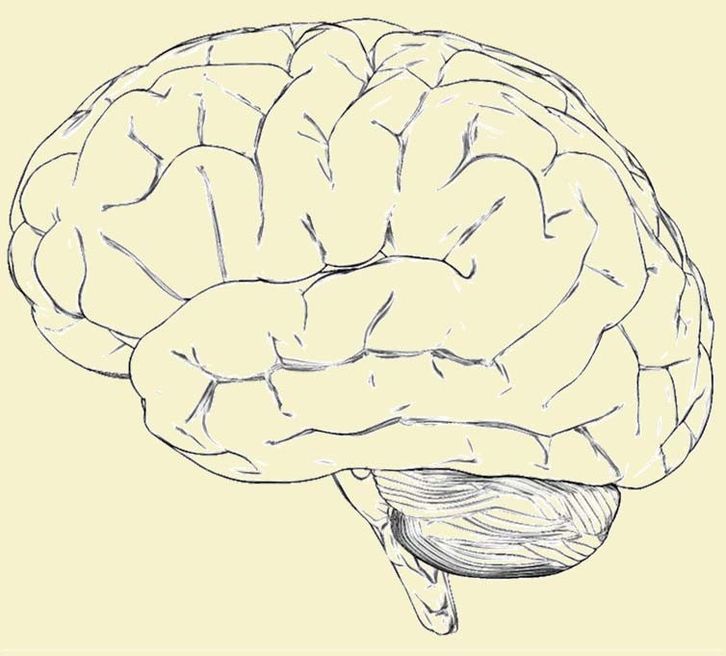
Introduction to Artificial Neural Network
Introduction to Nervous System
Analogy Between BNN and ANN
Introduction to ANN
Mohit Goel
Assistant Professor
School of Electronics & Electrical Engineering (SEEE)- D2
Mohit.16907@lpu.co.in

Slide 3
Biological nervous system
Biological nervous system is the most important part of many living things, in particular, human beings.
There is a part called brain at the centre of human nervous system.
In fact, any biological nervous system consists of a large number of interconnected processing units called neurons.
Each neuron is approximately 10µ long and they can operate in parallel.
Typically, a human brain consists of approximately 10¹¹ neurons communicating with each other with the help of electrical impulses.

Slide 4
Artificial neural network
A biological neuron receives all inputs through the dendrites, sums them and produces an output if the sum is greater than a threshold value.
The input signals are passed on to the cell body through the synapse, which may accelerate or retard an arriving signal.
It is this acceleration or retardation of the input signals that is modelled by the weights.
An effective synapse, which transmits a stronger signal will have a correspondingly larger weights while a weak synapse will have smaller weights.
Thus, weights here are multiplicative factors of the inputs to account for the strength of the synapse.

Slide 5
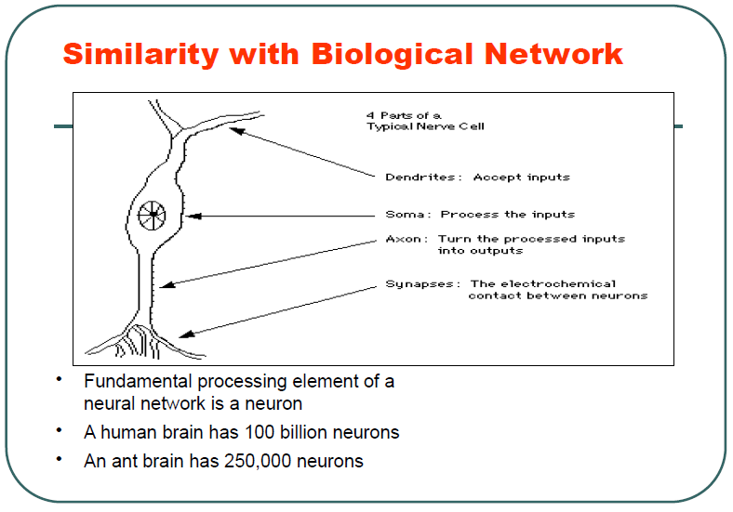

Slide 6
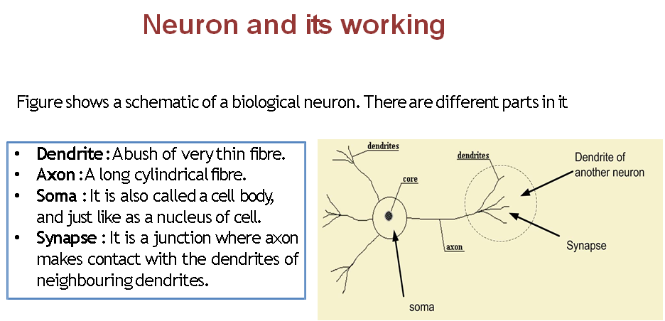
The Neuron - A Biological Information Processor
dendrites - the receivers
soma - neuron cell body (sums input signals)
axon - the transmitter
synapse - point of transmission
neuron activates after a certain threshold is meet
Learning occurs via electro-chemical changes in effectiveness of synaptic junction.

Slide 7
Quiz
What is the function of dendrites
A. It acts as transmitter B. It acts as receiver C. It acts as transmission point D. It acts as a cell body

Slide 8
Neuron and its working
There is a chemical in each neuron called neurotransmitter.
A signal (also called sense) is transmitted across neurons by this chemical.
That is, all inputs from other neuron arrive to a neurons through dendrites.
These signals are accumulated at the synapse of the neuron and then serve as the output to be transmitted through the neuron.
An action may produce an electrical impulse, which usually lasts for about a millisecond.
Pulse generated due to an incoming signal and all signal may not produce pulses in axon unless it crosses a threshold value.
An action signal in axon of a neuron is commutative signals arrive at dendrites which summed up at soma.

Slide 9
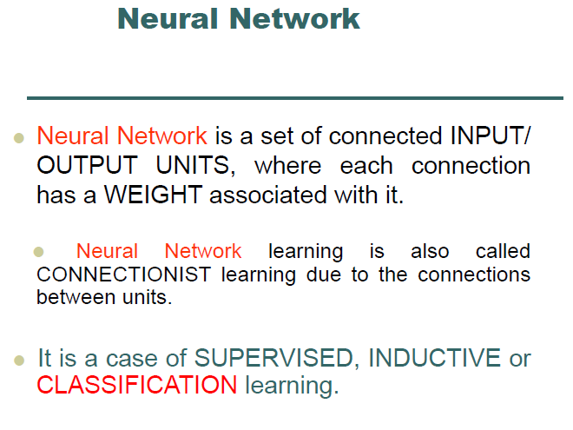

Slide 10
Quiz
What is soma
A. It acts as transmitter B. It acts as receiver C. It acts as transmission point D. It acts as a neuron cell body

Slide 11
Quiz
In the human nervous system, the supporting cells present with neurons are classified as
A. dendrite cells
B. malign cells
C. benign cells
D. neuroglial cells

Slide 12
Artificial neural network
In fact, the human brain is a highly complex structure viewed as a massive, highly interconnected network of simple processing elements called neurons.
Artificial neural networks (ANNs) or simply we refer it as neural network (NNs), which are simplified models (i.e. imitations) of the biological nervous system, and obviously, therefore, have been motivated by the kind of computing performed by the human brain.
The behaviour of a biological neural network can be captured by a simple model called artificial neuron or perceptron.

Slide 13
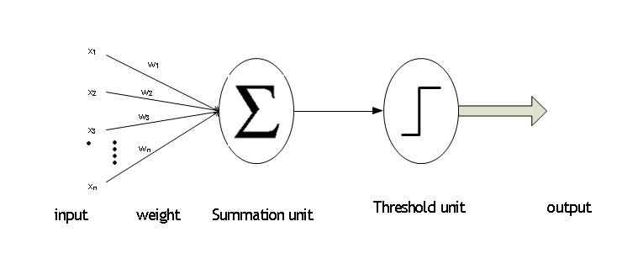

Slide 14
Artificial neural network
A neutron is a part of an interconnected network of nervous system and serves the following.
Compute input signals
Transportation of signals (at a very high speed)
Storage of information
Perception, automatic training and learning
We also can see the analogy between the biological neuron and artificial neuron. Truly, every component of the model (i.e. artificial neuron) bears a direct analogy to that of a biological neuron. It is this model which forms the basis of neural network (i.e. artificial neural network).

Slide 15
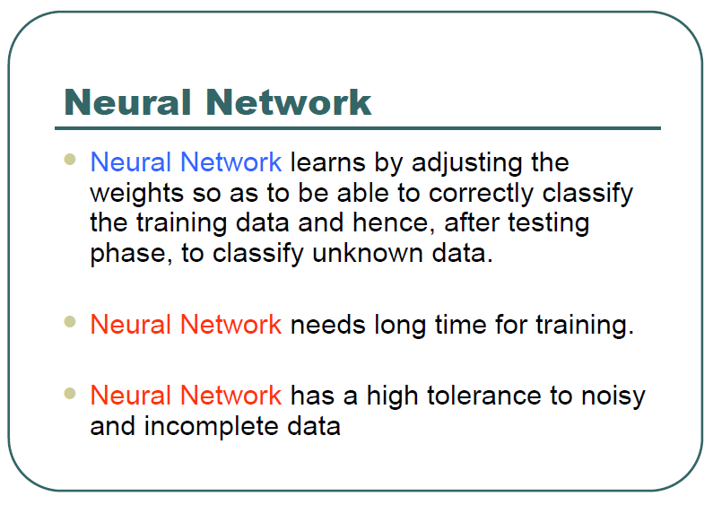

Slide 16
One Neuron as a Network

Slide 17
One Neuron as a Network
Here x1 and x2 are normalized attribute value of data.
● y is the output of the neuron , i.e the class label.
● x1 and x2 values multiplied by weight values w1 and w2 are input to the neuron x.
● Value of x1 is multiplied by a weight w1 and values of x2 is multiplied by a weight w2.
● Given that
• w1 = 0.5 and w2 = 0.5
• Say value of x1 is 0.3 and value of x2 is 0.8,
• So, weighted sum is :
• sum= w1 . x1 + w2 . x2 = 0.5 x 0.3 + 0.5 x 0.8 = 0.55

Slide 18
One Neuron as a Network
The neuron receives the weighted sum as input and calculates
the output as a function of input as follows :
• y = f(x) , where f(x) is defined as
• f(x) = 0 { when x< 0.5 }
• f(x) = 1 { when x >= 0.5 }
• For our example, x ( weighted sum ) is 0.55, so y = 1 ,
• That means corresponding input attribute values are classified in
class 1.
• If for another input values , x = 0.45 , then f(x) = 0,
• so we could conclude that input values are classified to
class 0.

Slide 19
Bias of a Neuron

Slide 22
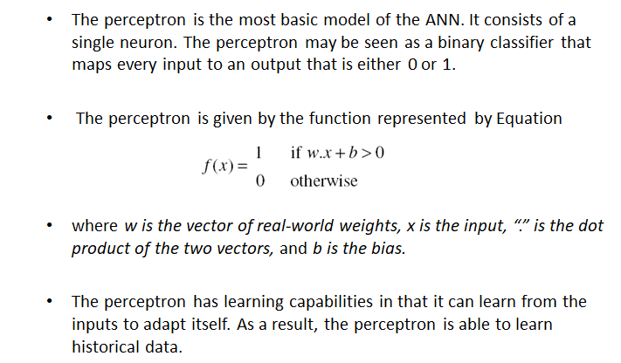
The Perceptron

Slide 23
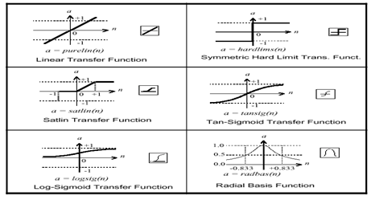
The activation function is generally non-linear. Linear functions are limited because the output is simply proportional to the input.

Slide 24
Quiz
Which unit is used for producing the sums of input signals
a) Dendrites
b) Axon
c) Soma
d) Population

Slide 25
Advantages of ANN
ANNs exhibits mapping capabilities, that is, they can map input patterns to their associated output pattern.
The ANNs learn by examples. Thus, an ANN architecture can be trained with known example of a problem before they are tested for their inference capabilities on unknown instance of the problem. In other words, they can identify new objects previous untrained.
The ANNs posses the capability to generalize. This is the power to apply in application where exact mathematical model to problem are not possible.

Slide 26
Neural network architectures
ANN Architecture
There are three fundamental classes of ANN architectures :-
Single layer feed forward architecture
Multilayer feed forward architecture
Recurrent networks architecture
Before going to discuss all these architectures, we first discuss the mathematical details of a neuron at a single level. To do this, let us first consider the AND problem and its possible solution with neural network.

Slide 27
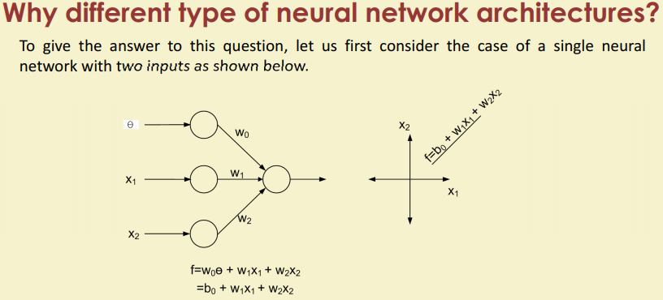

Slide 28
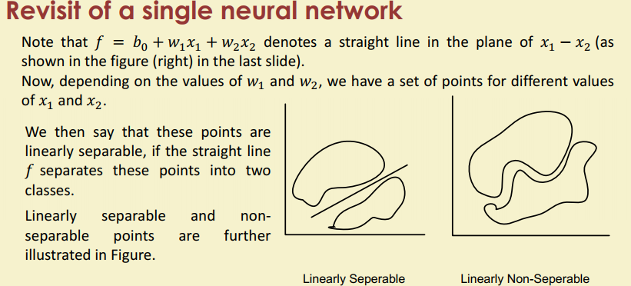

Slide 29
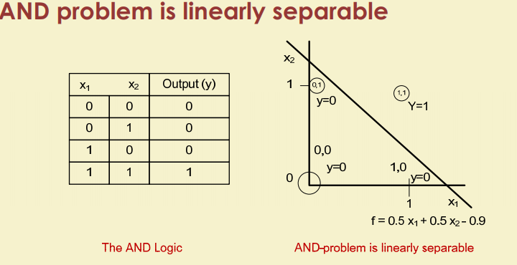

Slide 30
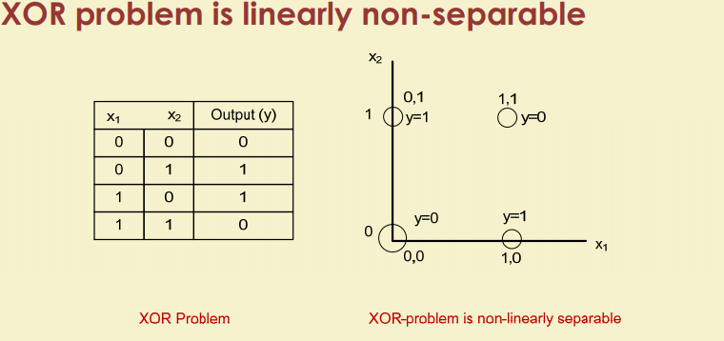

Slide 31
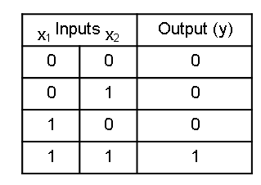
The AND problem and its Neural network
The simple Boolean AND operation with two input variables x₁and x₂ is shown in the truth table.
Here, we have four input patterns: 00, 01, 10 and 11.
For the first three patterns output is 0 and for the last pattern output is 1.
The AND Logic

Slide 32
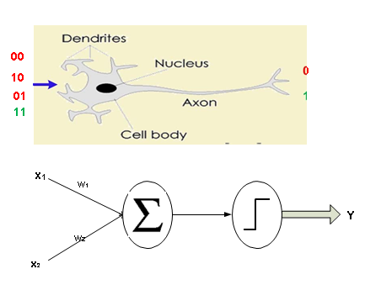
The AND problem and its Neural network
Alternatively, the AND problem can be thought as a perception problem where we have to receive four different patterns as input and perceive the results as 0 or 1.

Slide 33
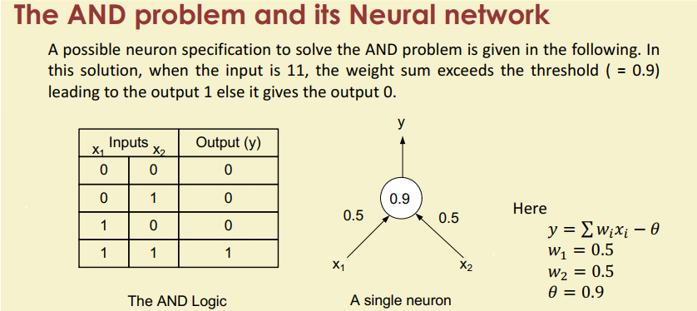

Slide 34
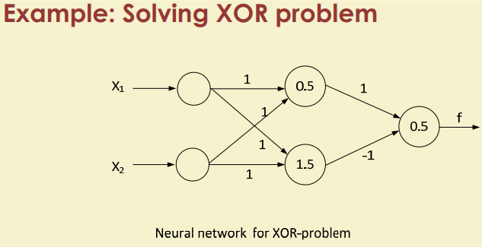

Slide 35
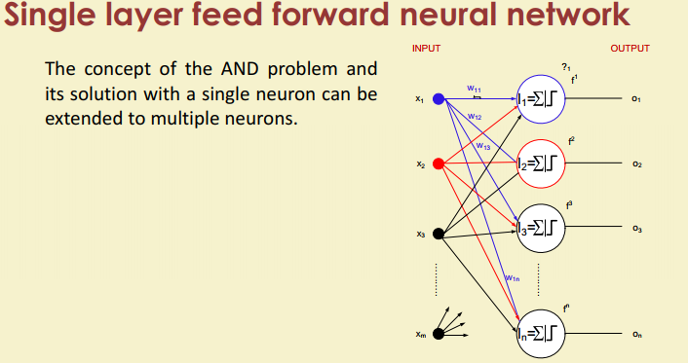

Slide 36
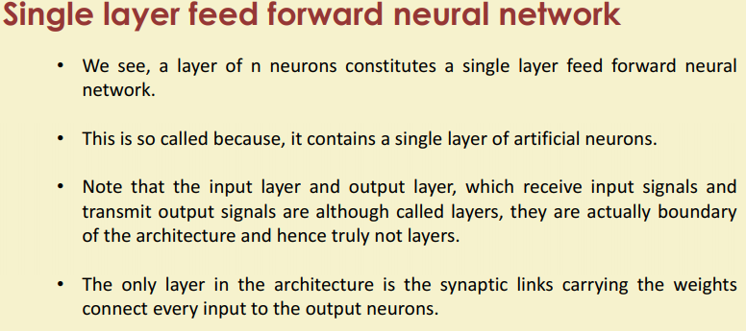

Slide 37
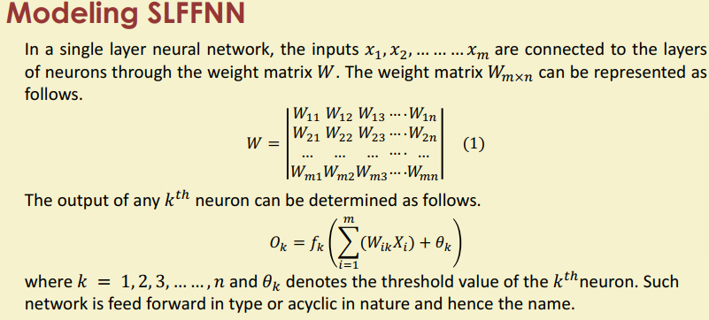

Slide 38
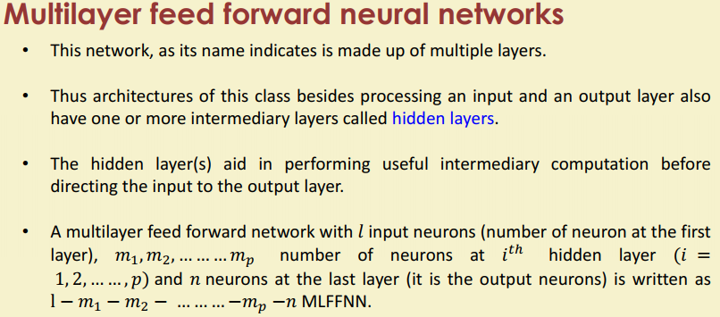

Slide 39
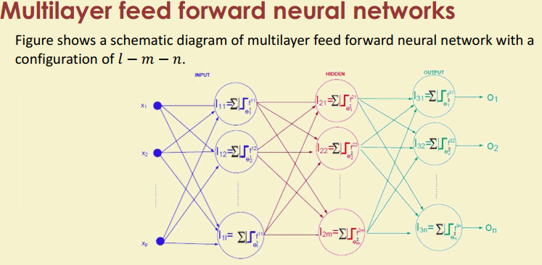

Slide 40
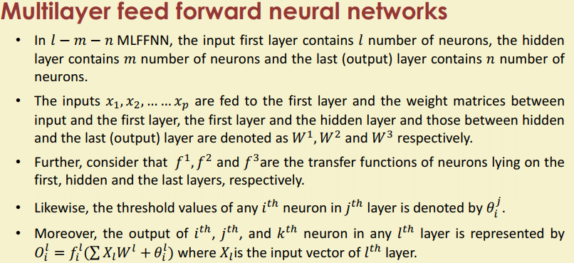

Slide 41
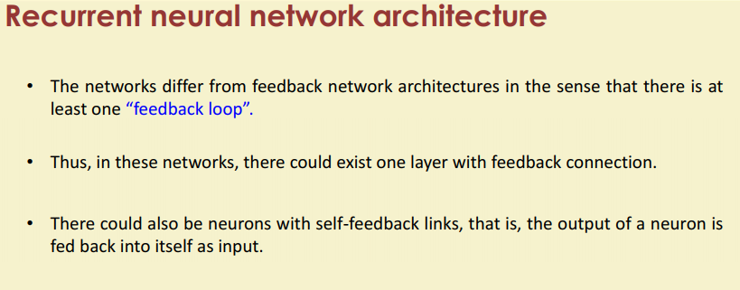

Slide 42
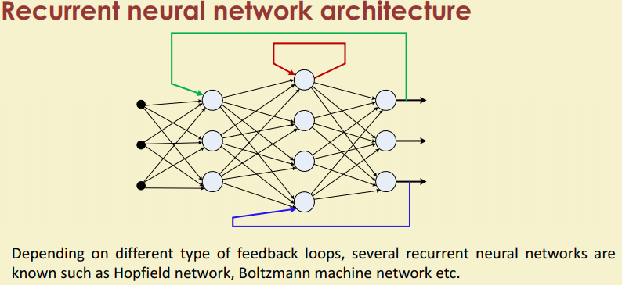

Slide 43
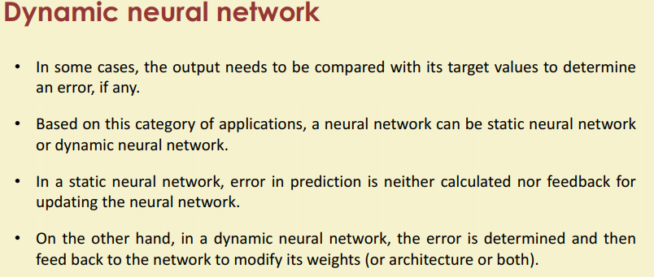

Slide 44
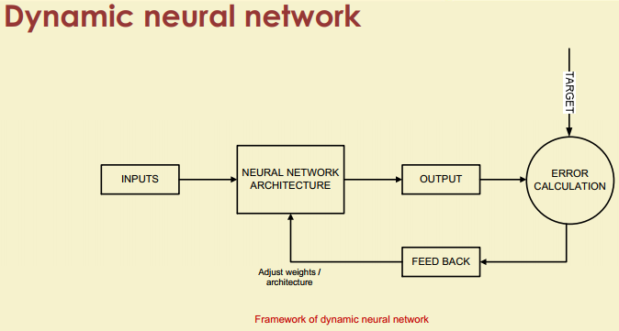

Slide 45
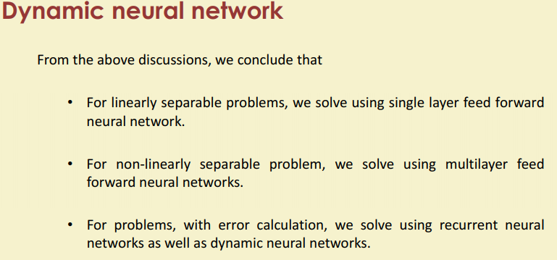

Slide 46
Quiz
How many types of Artificial Neural Networks?
A. 2 B. 3 C. 4 D. 5

Slide 47
Quiz
Explanation: There are two Artificial Neural Network topologies : FeedForward and Feedback

Slide 48
Quiz
In which ANN, loops are allowed?
A. FeedForward ANN B. FeedBack ANN C. Both A and B D. None of the Above

Slide 49
Quiz
What is the use of MLFFNN?
a) to realize structure of multilayer perceptron
b) to solve pattern classification problem
c) to solve pattern mapping problem
d) to realize an approximation to a multilayer perceptron

